Slide 1
PREDICTIVE ANALYTICS USING GAUSSIAN PROCESS
TEAM GUIDE:
Prof. S. VASAVI, MS, Ph.D
TEAM MEMBERS:
M. NAGARJUNA (138W1A0591)
N. AAKARSH (138W1A0560)
B. REVANTH (138W1A0566)
Y. MADHU (138W1A05C1)

Slide 2
TABLE OF CONTENTS
ABSTRACT
PROBLEM STATEMENT
LITERATURE REVIEW
DATASET
LIFE CYCLE
UML DIAGRAM
METHODOLOGY
IMPLEMENTATION
TEST RESULTS
REFERENCES

Slide 3
ABSTRACT
Predictive analytics is an area of data mining that deals with extracting information. The use of predictive analytics in government is presently less common but using it one can explore how tax administrations could make use of data mining to enhance tax compliance among the taxpayers and predict future tax of the government based on past observations. This predictive analysis is done using R Programming Language. In this project, Gaussian process Regression is used to predict the future values based on past observations from Income tax data set of the Government.
Keywords: Predictive Analytics, Regression, Gaussian process, Data Mining, R language, Tax Administration, Government.

Slide 4
PROBLEM STATEMENT
The main objective of this project is to build a model that predicts the future tax values based on the historical dataset using Gaussian process in R programming.
By predicting the values in advance it is possible to forecast trends, determine statistical probabilities and to act upon fraud if detected.
Performance of the classifier is measured using Normalised Root Mean Square Error (NRMSE) and Coefficient of Determination (COD)

Slide 5
LITERATURE REVIEW
The subject of “Big Data” is receiving increasing attention in many fields. Common examples include Amazon and Netflix, which use past data on customers to predict future choices.
A subfield of Big Data, predictive analytics (PA), including a subarea known as predictive risk modeling (PRM), has been applied in many areas.
Predictive models typically analyse current and historical data to produce easily understood metrics and predictive capabilities.
Predictive Analytics—What happens next?

Slide 6
Cont’d
Gaussian processes are traditionally used for regression on fixed data sets, to produce a single fixed set of predictions.
A Gaussian process is associated with a collection of random variables that produces a pool of functions relevant for prediction. In other words, Gaussian process is a distribution over functions.
Bayes’ rule allows us to update our probabilities in the light of new information.
Bayes’ Theorem hence provides a canonical rule for how any agent should reason on the basis of what information it has.

Slide 7
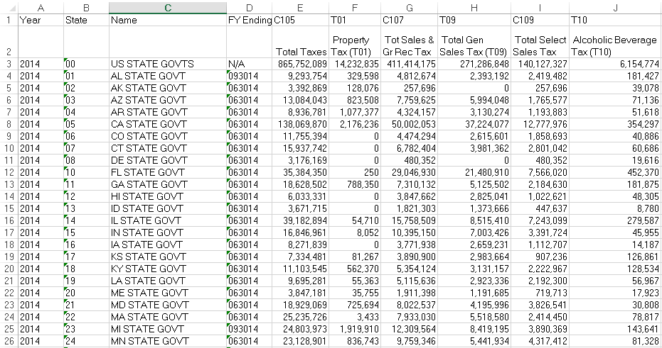
DATASET

Slide 8
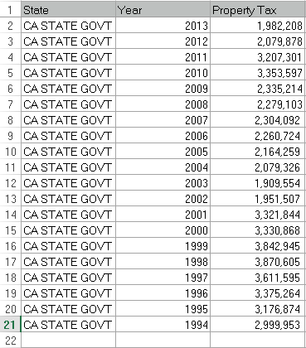
This data set contains tax values of 51 states in US for the past 72 years starting from 1942 to 2014. This dataset contains 31 different taxes.
We took this dataset from the following link :
http://www.census.gov/govs/statetax/historical_data.html.
Now to build a predictive model we have taken
a single tax value for a single state over the past
20 years.

Slide 9

LIFE CYCLE
CRISP-DM :
Cross Industry Standard Process for Data Mining, commonly known by its acronym CRISP-DM was a data mining process model that describes commonly used approaches that data mining experts use to tackle problems.

Slide 10
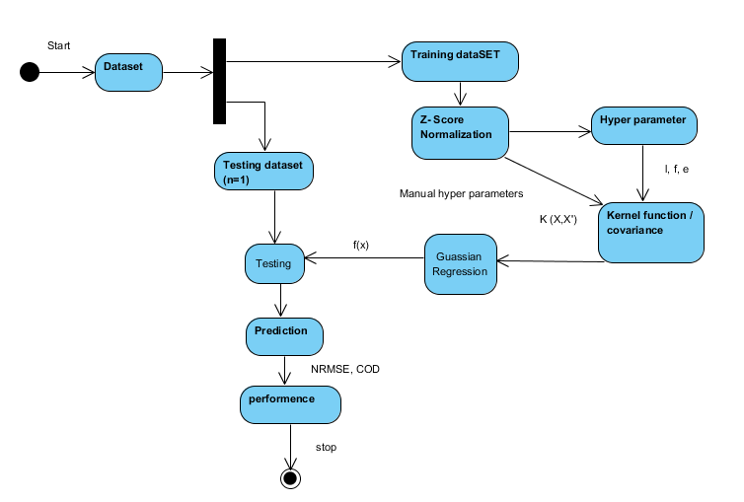
UML DIAGRAM

Slide 11
METHODOLOGY
Proposed algorithm for predictive analytics using Gaussian process
Input: Dataset
Step 1: Read the input dataset
Step 2: Add a column for which we want to predict
Step 3: Preprocessing using Z-score normalisation such that it will help speed up the learning phase
Step 4: Choose x ={xtrain, xtest}

Slide 12
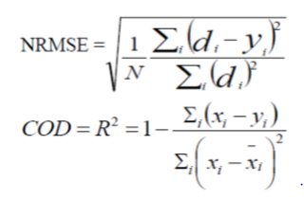
Step 5: Estimate Gaussian Process hyper-parameters θ (kernel and mean function parameters)
Step 6: Train the Bayesian model as in (3) using Xtrain
p(f |X, y) = p(y| f , X) p(f) ÷ p(y|X) (3)
Step 7: Evaluate the model using NRMSE and COD

Slide 13
IMPLEMENTATION
First we create a new project in R studio.
Now, we need to read the dataset using the following command:
data <- read.csv(“tax.csv”)
Later we pre-process the data using Z-score Normalisation
Xnew = (Xold – mean)÷standard deviation, where X represents the property tax values.
We find the mean and standard deviation using the functions:
mean <- mean(data$propertytax)
sd <- sd(data$propertytax)
To normalise the values of a column at a time, we use the following function:
data <- within(data, data$propertytax = (data$propertytax– mean)÷sd)

Slide 14
Cont’d
Now, we use Gaussian process Regression to predict the values.
The notation of Gaussian process is given as:
f(x) ∼ GP(m(x), k(x, x′))
where m(x) is the mean function and k(x, x′) is the covariance function.
In most of the prediction scenarios, the mean function is assumed to be zero, in which the average value of the functions at each x in the prior Gaussian becomes zero.
The covariance function k(x, x′), is also known as the kernel function of the Gaussian process.
The most commonly used covariance function is the Squared Exponential covariance function.
The problem is to learn a function from the dataset, which involves an assumed Gaussian prior of functions.

Slide 15
Cont’d
The observations and the underlying function f values are not the same due to the noisy measurements of the observations. Therefore the targets can be represented as:
y = f(x) + ε, where f(x) ∼ GP(0, k(x, x′)) and Gaussian noise model (ε ∼ N(0, σ_{n}² ))
Squared Exponential covariance function used in GP is
k(x, x’) = σ_{f ^2} exp[(x-x’)^2 / 2l^2]
In the above the parameters σ_{n ,} σf , l are known as Hyper-parameters in the kernel function, represented by
θ = {l,σ_{f}²,σ_{n}²}
where l is characteristic length scale, σ_{f}² is the signal variance and σ_{n}² is the noise variance.

Slide 16
Cont’d
These three parameters are obtained by learning the data. In general, it uses Bayesian model to infer these parameters. This method is known as marginal likelihood maximisation method.
According to the Bayes rule, we can represent the posterior probability of the parameters as follows:
^{p(θ|X, y) = p(y|X, θ)p(θ)} / p(y|X) , where p(y|X, θ) is the marginal likelihood which is to be maximised, and p(θ) is the prior probability of the parameters.
Now, after the hyper-parameters are known, we are able to find the kernel function k(x, x')
The covariance function related to the target values y, denoted as cov(x,x′), can be given by:
cov(x, x′) = k(x, x′) + σ_{n}² δ(x, x′) , where δ(x, x′) is the Kronecker delta function which is equal to 1 iff x = x′ and 0 otherwise.
Using the kernel function, the correlation between each and every training data point can be measured and stored in the matrix called Covariance matrix and denoted by K.

Slide 17
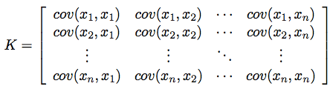
Cont’d
The corresponding covariance matrix between the training data points and the test data points is given by K∗:
K∗ = [cov(x∗, x₁) cov(x∗, x₂) · · · cov(x∗, x_{n})], where x_{∗ is test data point}
K∗∗ specifies the covariance matrix between the test data points itself.
K∗∗ = cov(x∗, x∗)
The actual prediction is given by the conditional distribution of y∗ given y
y∗|y ∼ N(K∗K⁻¹y, K∗∗ − K∗K⁻¹K∗^{T} )
This distribution is known as the posterior Gaussian distribution. According to Rasmussen and Williams[5], for any Gaussian posterior, the mean of the posterior distribution is called as the Maximum a Posteriori (MAP) value, which is the best estimate for the variable considered.

Slide 18
Cont’d
Therefore, the prediction value for the test data point x∗ is the mean in the above equation i.e,
y ̄∗ = K∗K⁻¹y
Now, we evaluate the predictive model using NRMSE and COD.
The libraries that are required for the implementation of this algorithm are
_{MASS}
_{plyr}
_{reshape2}
_{ggplot2}
The package required is gptk package to implement Gaussian process regression.

Slide 19
install and load the gptk package
# Load in the required libraries for data manipulation
# and multivariate normal distribution
require(MASS)
require(plyr)
require(reshape2)
require(ggplot2)
set.seed(12345)
#Normalize of data
tax <- read.csv(â€œdata.csvâ€)
attach(tax)
pt.mean <- mean(pt)
pt.sd <- sd(pt)
year.mean <- mean(Year)
year.sd <- sd(Year)
tax <- within(tax, pt <- (pt - pt.mean)/pt.sd)
tax <- within(tax, Year <- (Year - year.mean)/year.sd)
detach(tax)

Slide 20
train <- tax[2:20,]
test <- tax[1,]
xtrain <- train$Year
ytrain <- train$pt
xtest <- test$Year
ytest <- test$pt
# Calculates the covariance matrix sigma using a
# simplified version of the squared exponential function.
# Parameters:
# X1, X2 = vectors
# l = the scale length parameter

Slide 21
# Returns:
# a covariance matrix
calcSigma <- function(X1,X2,l=1) {
Sigma <- matrix(rep(0, length(X1)*length(X2)), nrow=length(X1))
for (i in 1:nrow(Sigma)) {
for (j in 1:ncol(Sigma)) {
Sigma[i,j] <- exp(-0.5*(abs(X1[i]-X2[j])/l)^2)
}
}
return(Sigma)
}

Slide 22
# 1. Plot some sample functions from the Gaussian process
# Define the points at which we want to define the functions
x.star <- seq(-2,2,len=50)
# Calculate the covariance matrix
sigma <- calcSigma(x.star,x.star)
# Generate a number of functions from the process
n.samples <- 3
values <- matrix(rep(0,length(x.star)*n.samples), ncol=n.samples)
for (i in 1:n.samples) {
# Each column represents a sample from a multivariate normal distribution
# with zero mean and covariance sigma
values[,i] <- mvrnorm(1, rep(0, length(x.star)), sigma)
}

Slide 23
f <- data.frame(xtrain,ytrain)
# Calculate the covariance matrices
# using the same x.star values as above
k1 <- calcSigma(xtrain, xtrain)
k3 <- calcSigma(xtrain, x.star)
k2 <- calcSigma(x.star, xtrain)
k4 <- calcSigma(x.star, x.star)
sigma.n <- 0.1
# Recalculate the mean and covariance functions
f.bar.star <- k2%*%solve(k1 + sigma.n^2*diag(1, ncol(k1)))%*%f$ytrain
cov.f.star <- k4 - k2%*%solve(k1 + sigma.n^2*diag(1, ncol(k1)))%*%k3
# Recalulate the sample functions
values <- matrix(rep(0,length(x.star)*n.samples), ncol=n.samples)
for (i in 1:n.samples) {
values[,i] <- mvrnorm(1, f.bar.star, cov.f.star)
}

Slide 24
values <- cbind(x=x.star,as.data.frame(values))
values <- melt(values,id="x")
graph <- ggplot(values, aes(x=x,y=value,colour=variable,group=variable)) + geom_line()

Slide 25
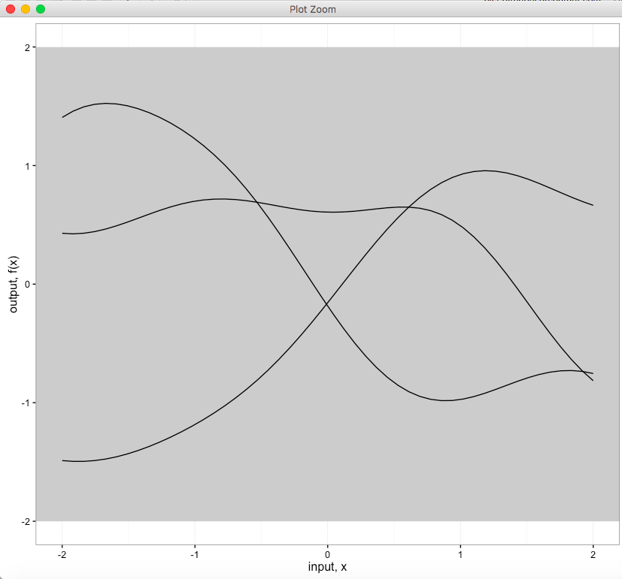
TEST RESULTS
These three lines are the samples of gaussian process i.e, gaussian functions . These functions are plotted using ggplot function in the ggplot package. This is the graph generated before the actual training of the data is done.
Now, we should build a model by using gaussian functions

Slide 26
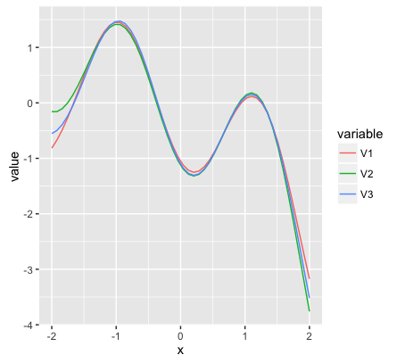
After training the data using the gaussian process the graph that is generated is shown here.
This graph is plotted with x -coordinate as year and y-coordinate as property tax (pt).
The prediction value for our test data is given by the mean of the gaussian function which is
f.bar.star in the above code.

Slide 27
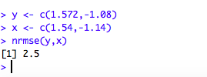
The predicted value for CA- state for the year 2013 is -1.08.
The predicted value for AR- state for the year 2013 is 1.572
The observed values for the above states for the year 2013 are -1.14 & 1.54
The performance of the model is given by NRMSE function which gives error rate in the predicted values .

Slide 28
REFERENCES
[1]Raghavendra Kune, Pramod Kumar Konugurthi, Arun Agarwal, Raghavendra Rao Chillarige, and Rajkumar Buyya, The Anatomy of Big Data Computing, journal of Software—Practice & Experience, john wiley publishers 2016
[2]Dr. Thomas Packard, “ SACHS Literature Review: Predictive Analytics in Human Services” , February 2016.
[3]Michael Osborne, “Gaussian Processes for Prediction Technical Report” , October 4, 2007
[4]Gustau Camps-Valls, Jochem Verrelst, Jordi Munoz-Mari, Valero Laparra, Fernando Mateo-Jimenez, and Jose Gomez-Dan, “A Survey on Gaussian Processes for Earth- Observation Data Analysis” IEEE Geoscience and remote sensing magazine, Image licensed by Ingram publishing, JUNE 2016
[5]C. E. Rasmussen & C. K. I. Williams, Gaussian Processes for Machine Learning, the MIT Press, 2006, ISBN 026218253X. 2006 Massachusetts Institute of Technology.

Slide 29
THANK YOU

